Slide 1
Reversal New Highs
Mohammed Chowdhury, Yuhuan Huang, Minxiang Jiang

Slide 2
Reversal New Highs Pattern (For Longs)
Must be an outside day
Must be 60 day high
Must have largest range of the past 5 days
Buy at tomorrow’s open
Use a trailing stop for exit point
Reversed for shorts

Slide 3
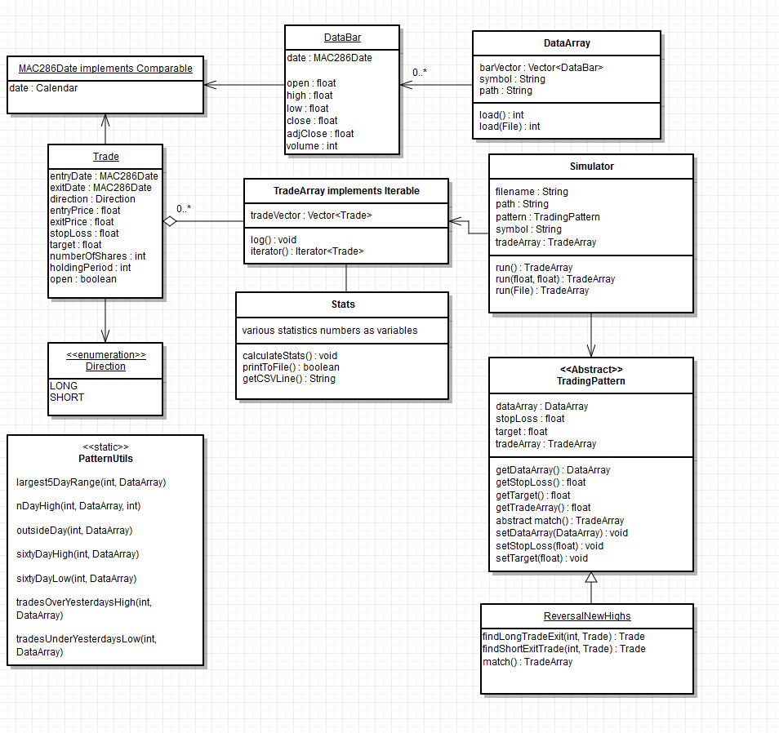

Slide 4
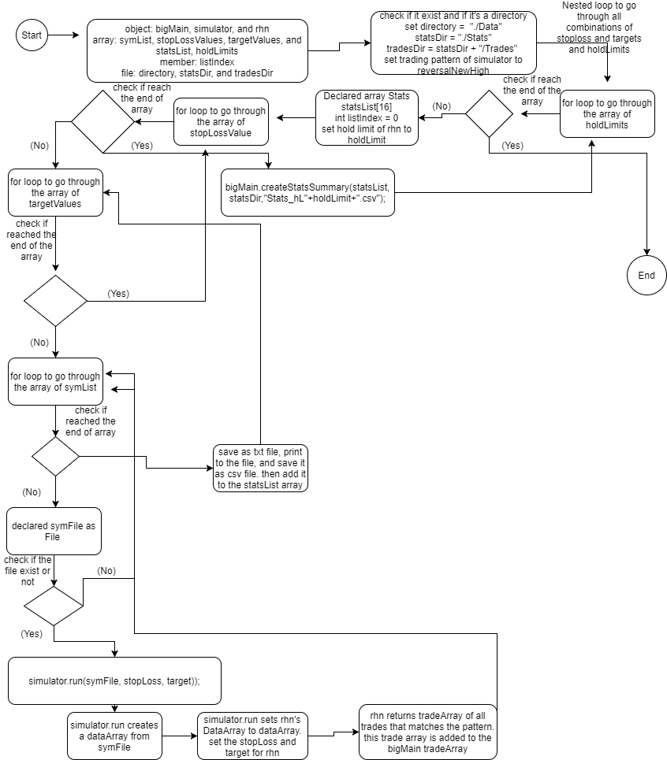

Slide 5
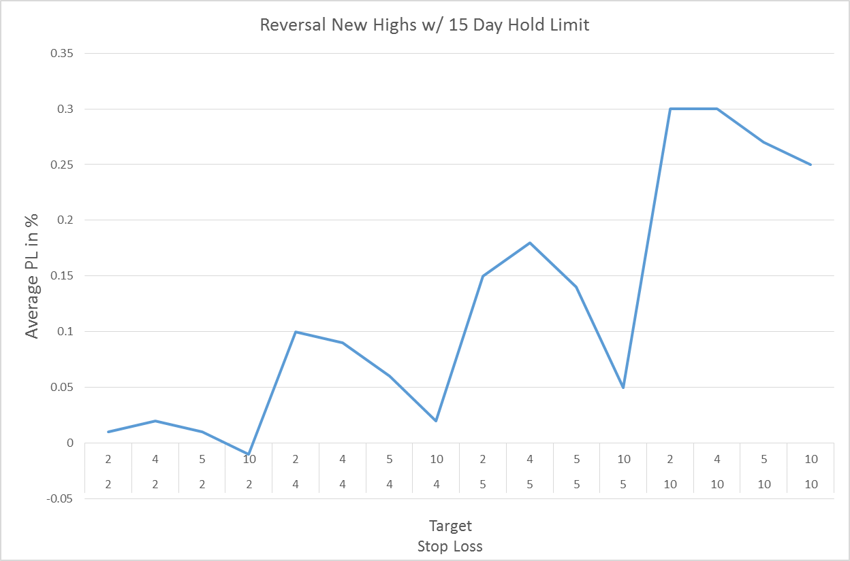

Slide 6
Reversal New Highs w/ 15 Day Hold Limit

Slide 7
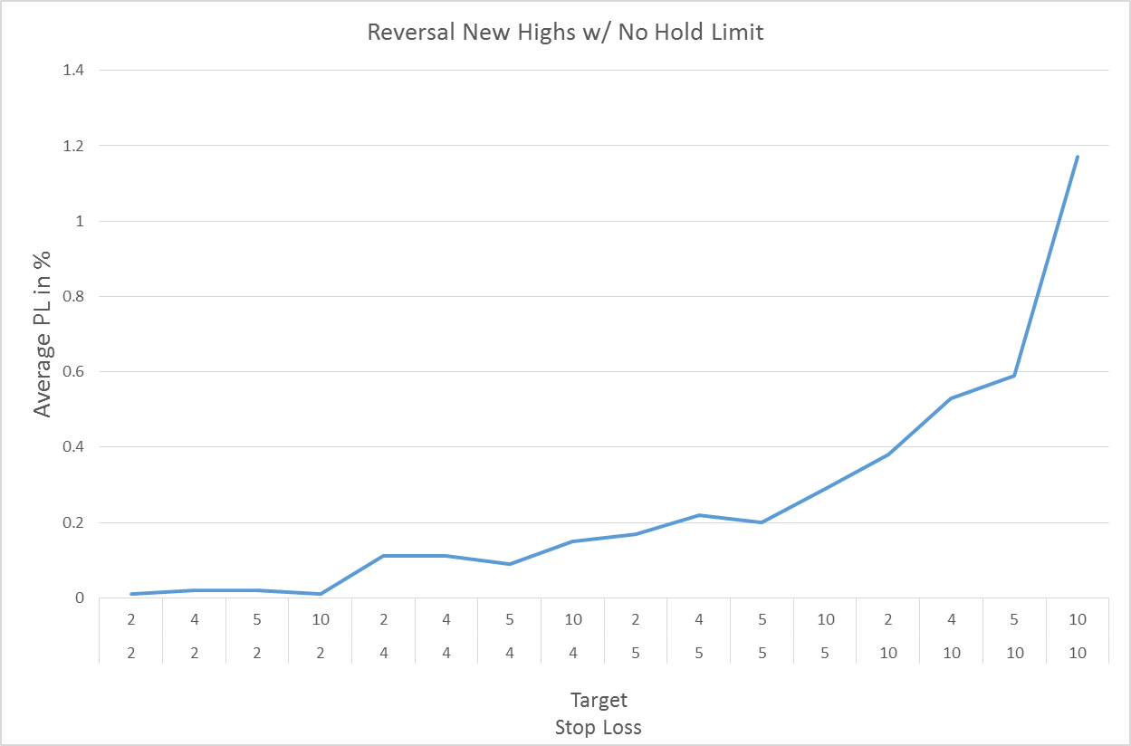

Slide 8
Reversal New Highs w/ No Hold Limit

Slide 9
Conclusions
In general, Reversal New Highs is not a very successful pattern. Although the average PLs are positive, it often has negative PLs for shorts.
Even for successful combinations of stop loss and target values, the average PL is not very high (often below 1%).
If you execute the pattern without a holding period limit, you end up holding for very long periods of times with mediocre PLs.
Changing the number for 60 day high to higher numbers (example: 120 day high) seems to increase the PL but it also decreases the number of trades and the results are still not great.

